Slide 1




Slide 2
General | Tema | Data |  | Ejemplos
Affiliations | Etnia | Poblacion por etnia |  | Conocer lugares, lugares importantes.
 | Religion | Poblacion por religion (tipo/secta) |  | Edificios religiosas ( iglesias, sinagogas, mezquitas)
 | Grupos y Organizaciones | Grupos formales e informales. |  | Sedes: Vecindarios (Limites y nombres)
Poblaciones | Demografia | Rasgos Poblacionales (genero, edad) o |  | Tipos de unidad de vivienda, Sitio Institucionales.
 | Economia | Indicadores | Infraestructura
 |  | Indicadores de Riqueza, Indicadores de Sueldo. | Capacidad de energia (energia renovable) | Infraestructura: Bloques de electricidad, lineas telefónicas,torres de celulares. Merados y centros comerciales. Zonas de actividad economic. activity zones
 | Educacion | Educacion Tazas de alfabetismo | Escuelas | Lugares de escuelas, sitios y nombres.
 | Salud y Medicina | Indicadoes de salud | Infraestructura para servicios medicos. | Hospitales, farmacias, clinicas medicas
Interacciones | Lenguage | Distribucion de Dialectos |  | Lugares Bilingues
 | Comunicación y uso de medios de informacion | Media Lugares y tipos de Medios de Comunicaciones; genero: editorial, educacional, emergencia , entretenimiento |  | Torres de Celulares, Lines telefoicas Estaciones televisivas,Oficinas de correo.
 | Uso de Transporte | Redes de Carreteras, Rieles , Aeropuertos, Buses |  | Paradas de autobus ; Lineas ferreas.
Ambiente | Control y manejo de agua | Puntos de Acceso Lugares de Manejo de Agua Rios,Pozos |  | Recojo de agua de lluvia , Pozos (cabados/perforados), cameras publicas, , Camiones cisterna, agua en maquinas expendedoras (rutas de entrega)
 | Tierra | Uso de la tierra/Cubierta de tierras Propiedad Significado Cultural |  | Zonificacion; uso de tipos de terreno (espacios abiertos , parques, gobierno, religioso, residencial)
Historia | Eventos significativos | Desastres Naturales; Cambios Politicos ; Tratados |  | Lugares de Eventos, tipos, recurrencia, causa

Slide 3

General | Theme | Data |  | Examples
Affiliations | Ethnicity | Population by ethnicity |  | Meeting places; important sites
 | Religion | Population by religion(type/sect) |  | Religious buildings (churches, synagogues, mosques)
 | Groups and Organizations | Formal and informal groups; |  | Headquarters; neighborhoods (boundary and name)
Populations | Demography | Population characteristics (gender, age) |  | Housing unit type; Institutional sites
 | Economy | Indicators | Infrastructure
 |  | Wealth indicators, Income indicators | Energy capacity (renewable energy) | Infrastructure: electricity grid, telephone lines, cell towers Markets and shopping centers; Economic activity zones
 | Education | Education/ Literacy rates | Schools | School sites, names and level
 | Health and Medical | Health indicators | Infrastructure for medical services | Hospitals, pharmacies, medical clinics
Interactions | Language | Distribution of dialects |  | Bilingual sites
 | Communications and Media Use | Media sites and types; genre: editorial, educational, emergency, entertainment |  | Cell towers, Telephone lines Television stations, Post Offices
 | Transportation Use | Road network, Railways, Airports, Buses |  | Bus stops; rail lines
Environment | Water Supply and Control | Access points Water treatment facilities Rivers, Wells |  | Rainwater harvesting, Wells (drilled/dug), public tap, Spring, Tanker truck, Vendor-provided water (routes of delivery)
 | Land | Land use/Land cover Ownership Cultural significance |  | Zoning; land use types (open space, parks, government, religious, residential)
History | Significant Events | Natural disasters; Political changes; Treaties |  | Sites of events, type, recurrence, cause

Slide 4

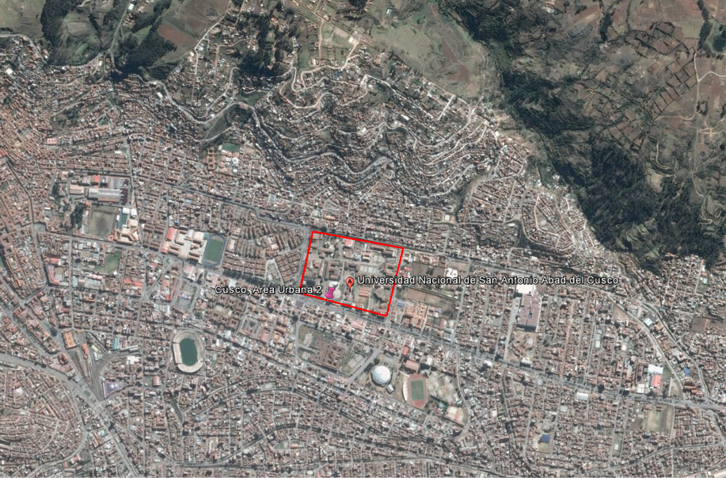
Definir los barrios cercanos a la Universidad

Slide 5
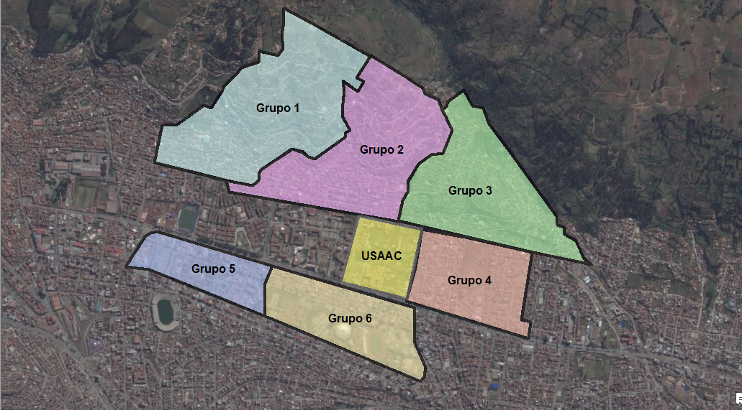
Download from Cusco GeoNode: http://cuscogeonode.state.gov/

Slide 6
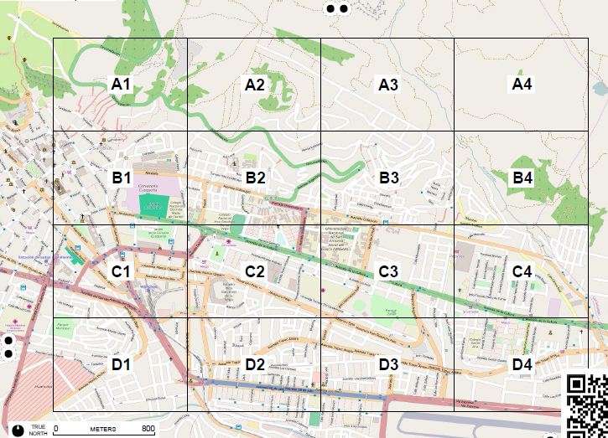
FieldPapers: OSM
http://fieldpapers.org/

Slide 7
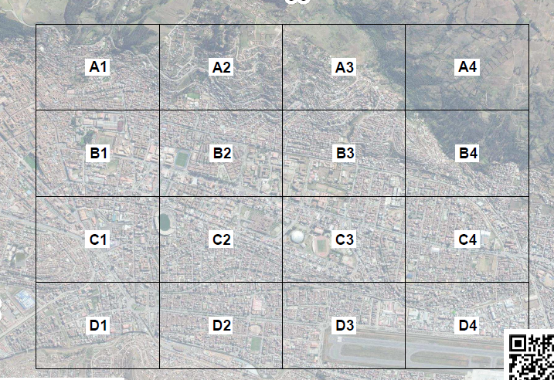
FieldPapers: Satellite Image
http://fieldpapers.org/

